Slide 1
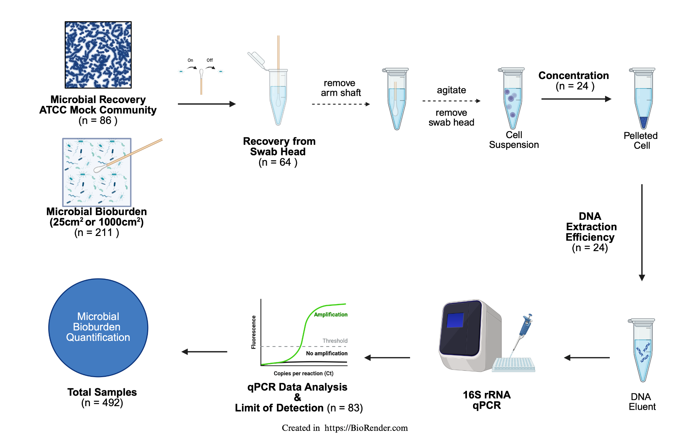
Figure 1
Notes:
Figure 1 caption: Overview of the experimental workflow used to evaluate microbial DNA recovery and assay performance in support of planetary protection objectives.

Slide 2
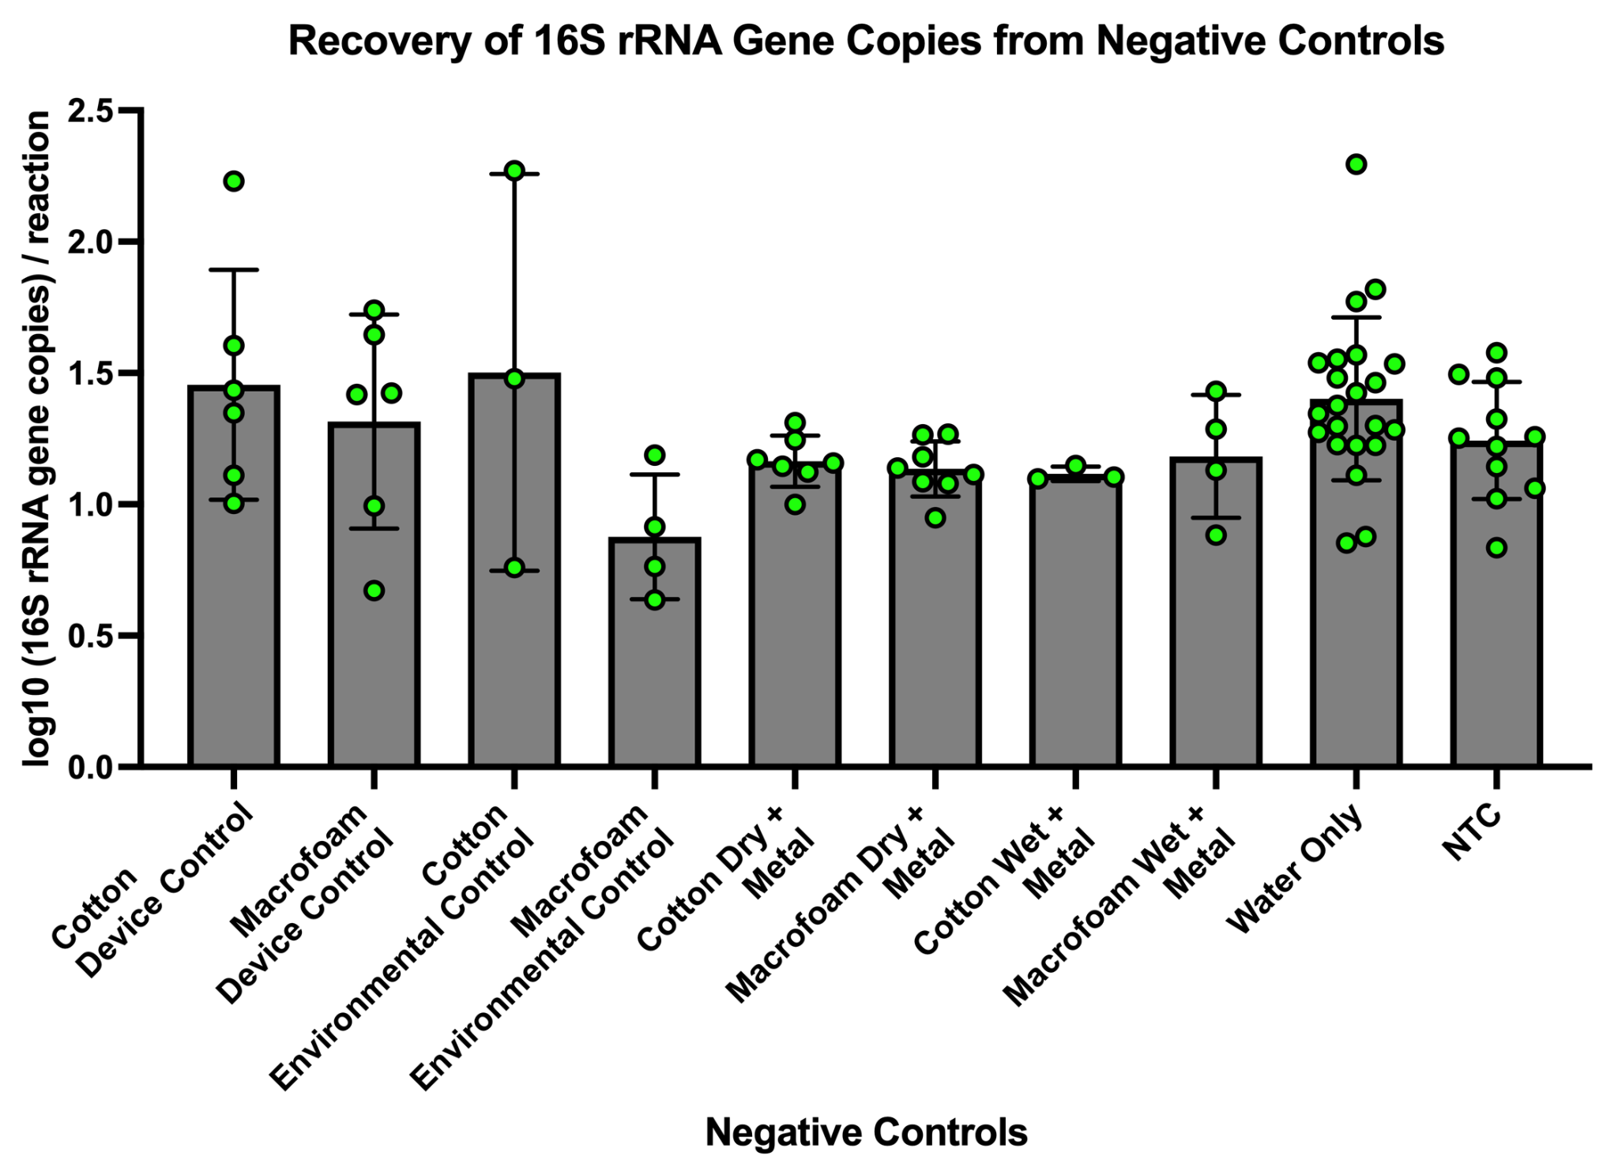
Figure 2
Notes:
Figure 2 caption:

Slide 4
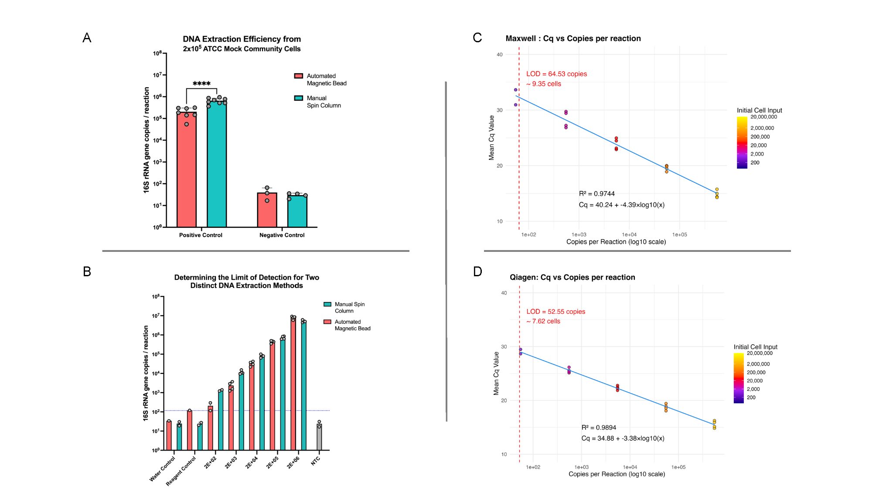
Figure 3
Notes:
Figure 3 caption:

Slide 5
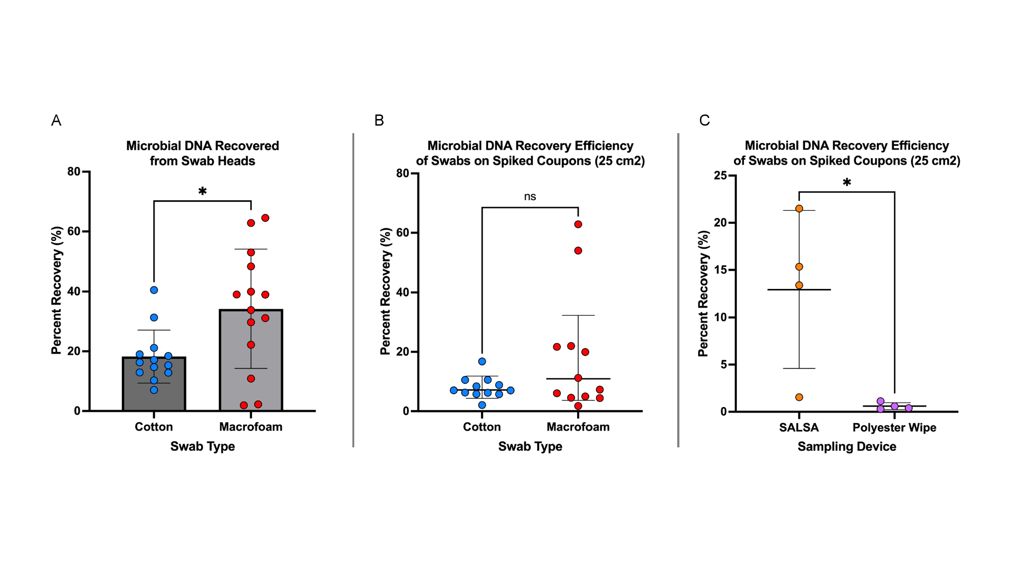
Figure 4
Notes:
Figure 4 caption:

Slide 6
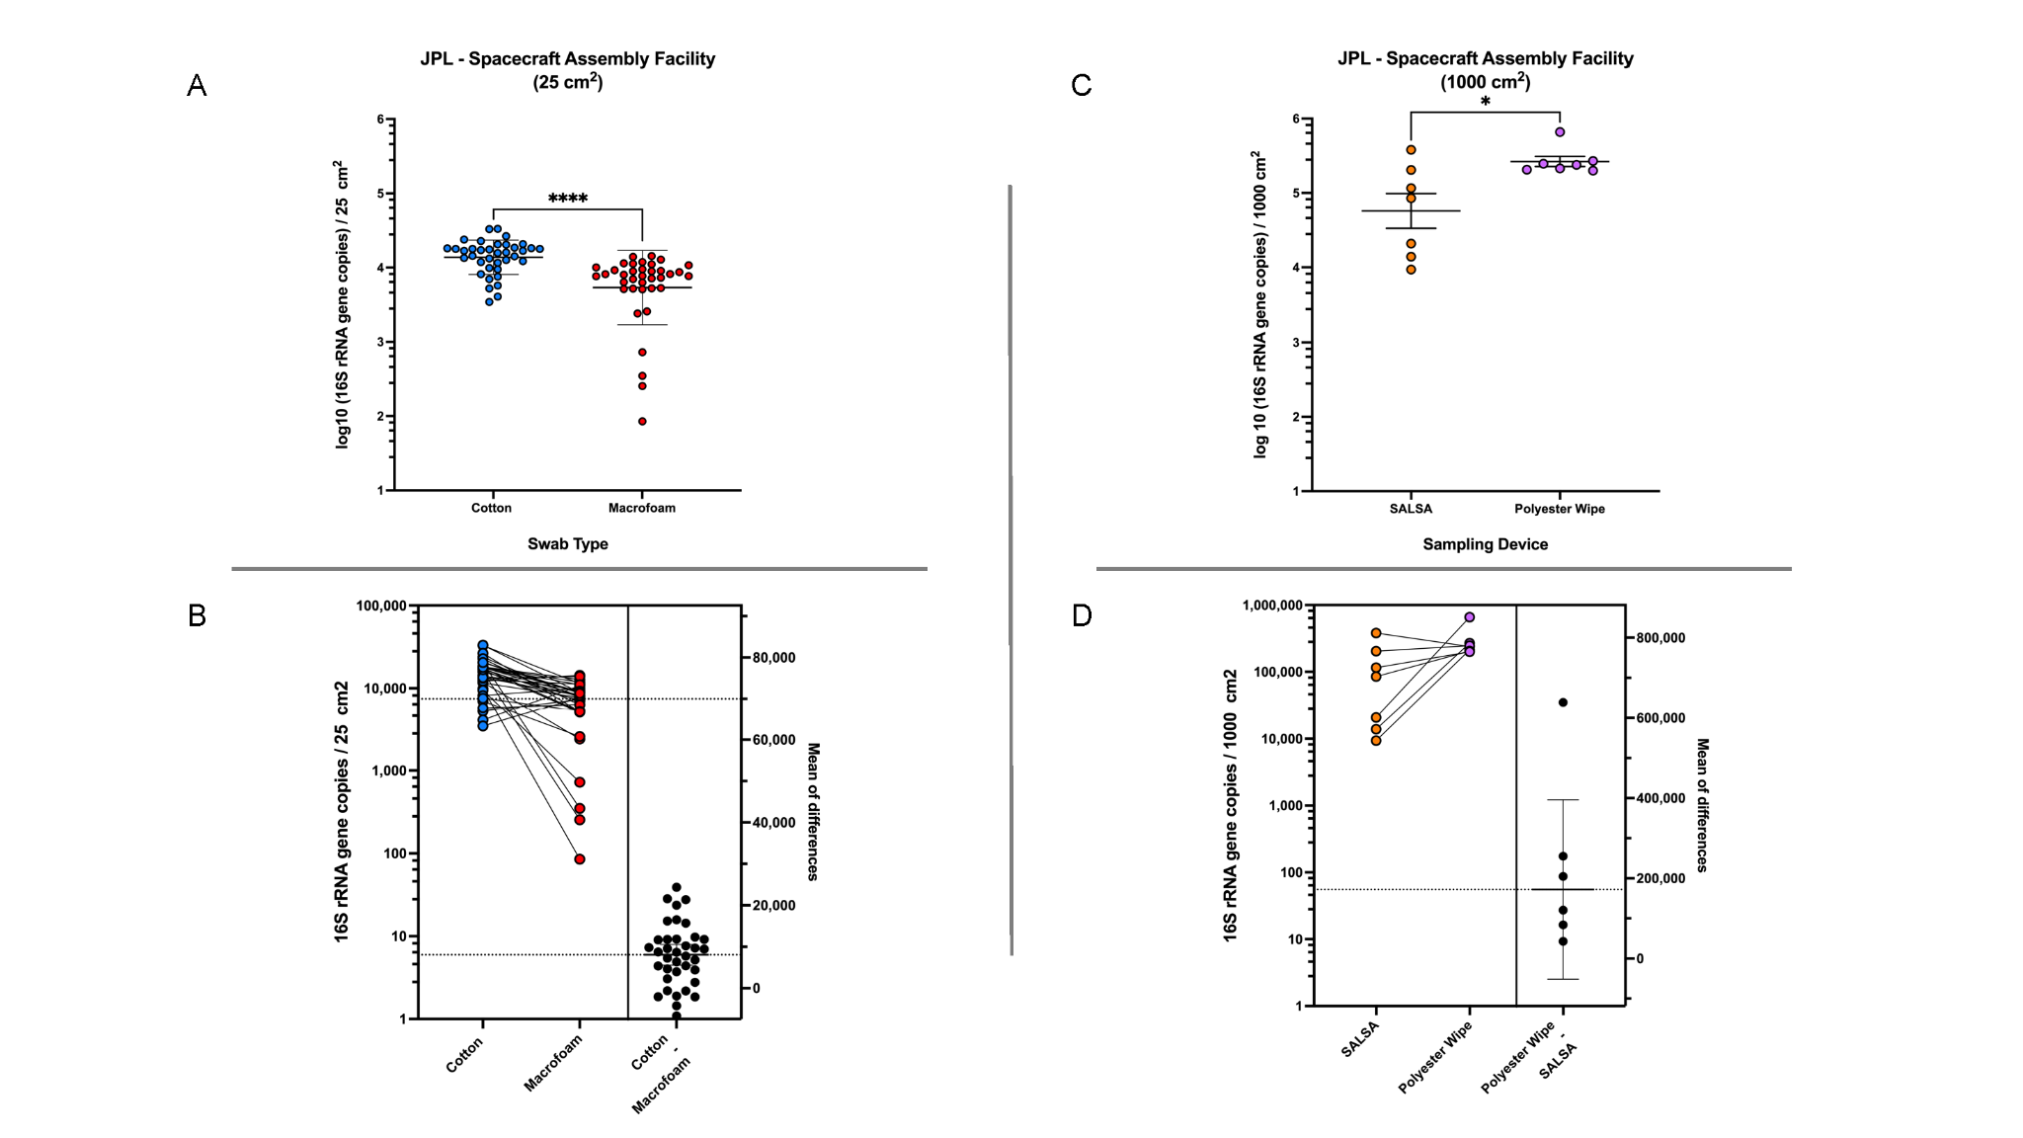
Figure 5
Notes:
Figure 5 caption:

Slide 7
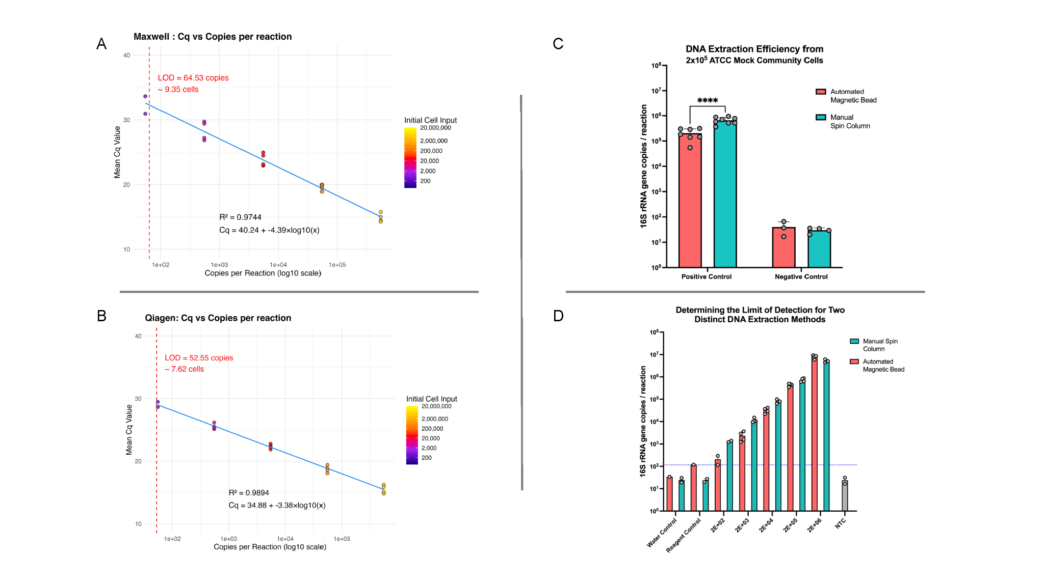
Figure 3
Notes:
Figure 3 caption:

Slide 8
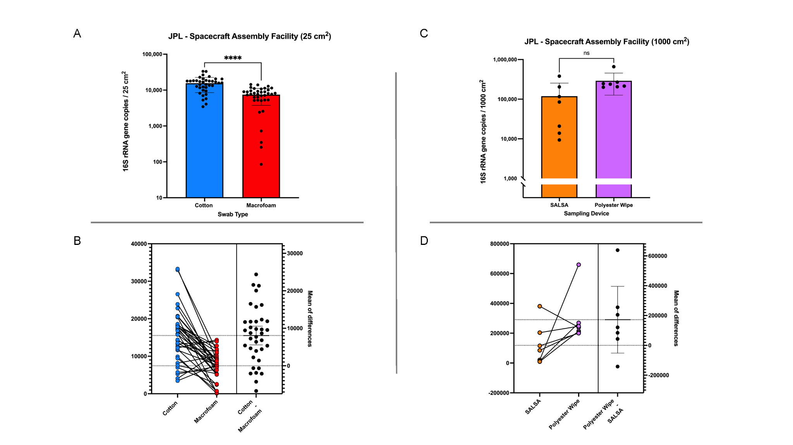
Figure 5
Notes:
Figure 5 caption:

